Slide 1









PLANTING SEEDS OF HOPE
World Day of the Poor 2025
PLANTING SEEDS OF HOPE

Slide 2
WHAT IS WORLD DAY
OF THE POOR?
  Introduced by Pope Francis in 2017
  A day when we think about people who have less than we do
  It reminds us to care for others, just like Jesus did
  This year, World Day of the Poor is the 16th November 2025
PLANTING SEEDS OF HOPE

Slide 3
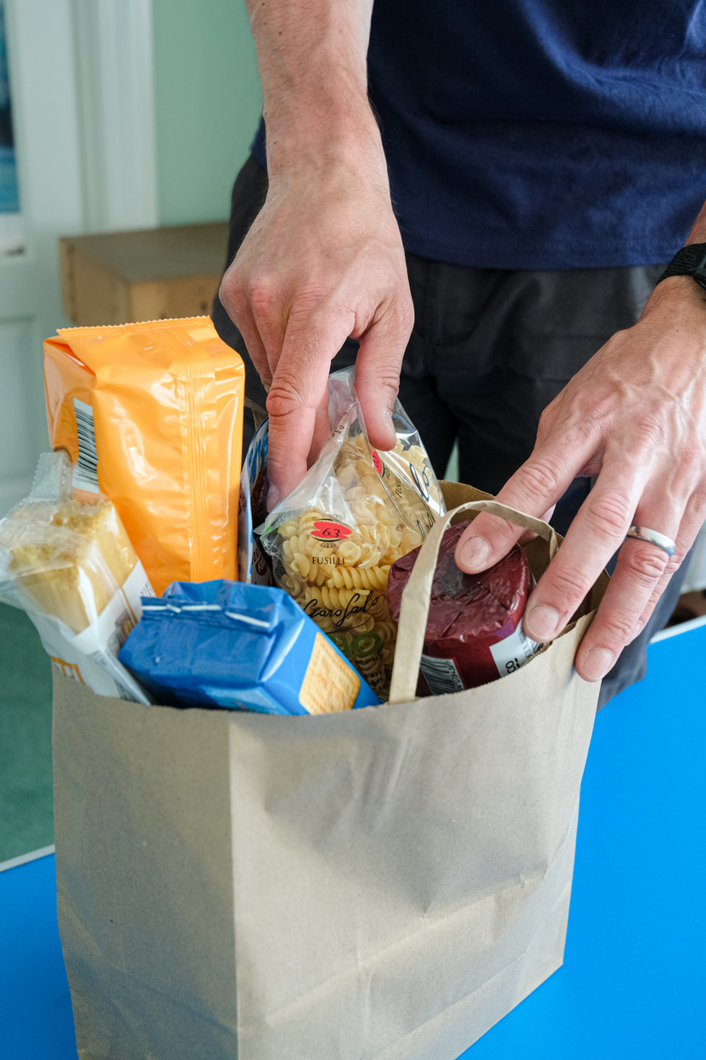
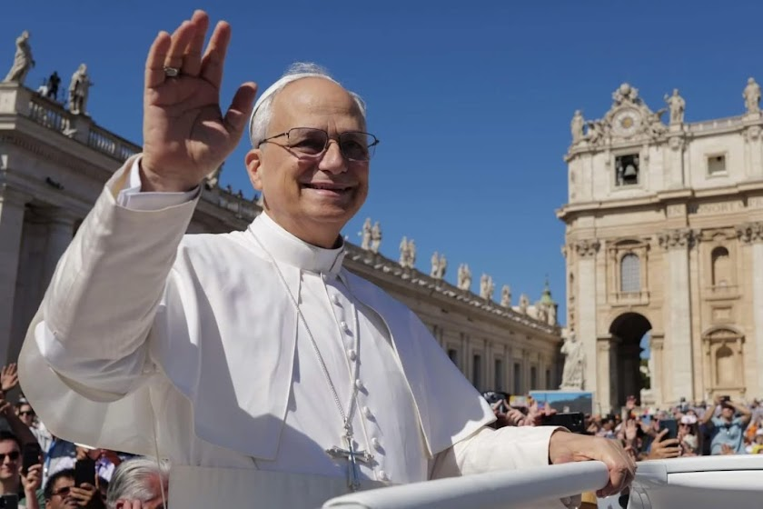
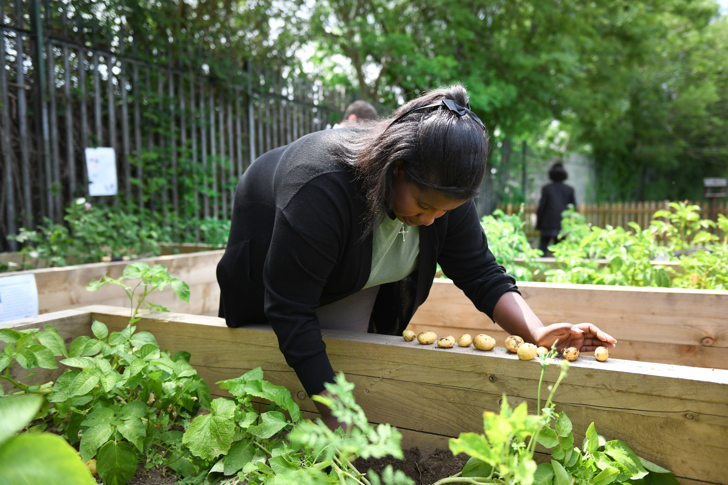
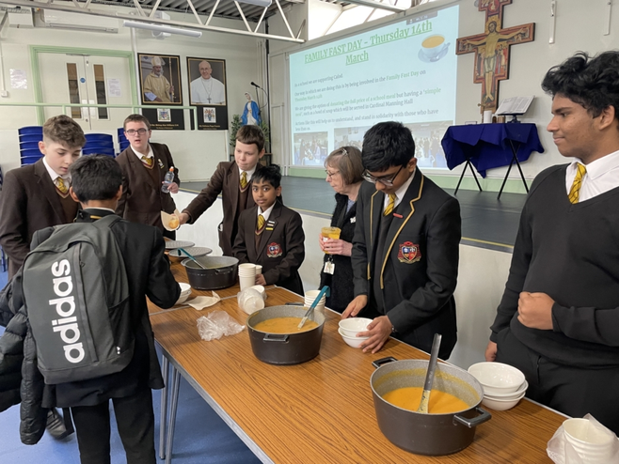

WHAT DID POPE LEO SAY THIS YEAR?
He reminded us to show love to the poor, telling us
that even small acts of kindness are seeds of hope
that can grow into something amazing.
Pope Leo also said that the poor can teach us hope
because they trust God deeply, even though they have
very little.
PLANTING SEEDS OF HOPE

Slide 4


Remember:
Hope is like a tiny seed,
It starts small, but it can grow
into something big and beautiful
WHAT DOES “HOPE”MEAN?
  Believing that something good can happen
  Trusting that God is with us
  A way to look forward to something
PLANTING SEEDS OF HOPE

Slide 5

WHO ARE THE POOR?
We might not always notice them, but they are a part of our community and need our help, support and prayers.
Can’t go
to school
Don’t have
enough food
Have few
clothes
Feel lonely
or left out
Don’t have
a home
Have little or
no money
PLANTING SEEDS OF HOPE

Slide 6
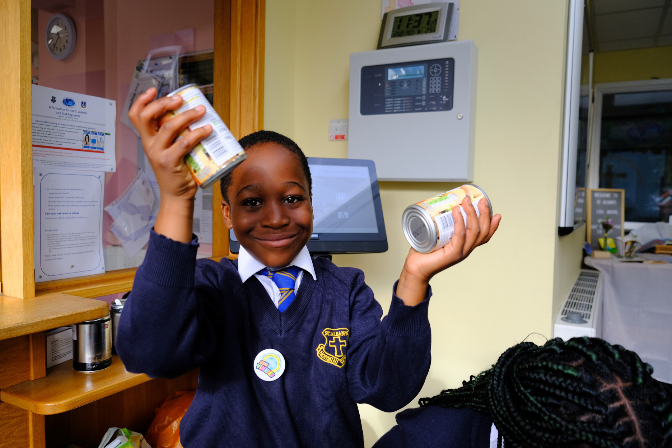
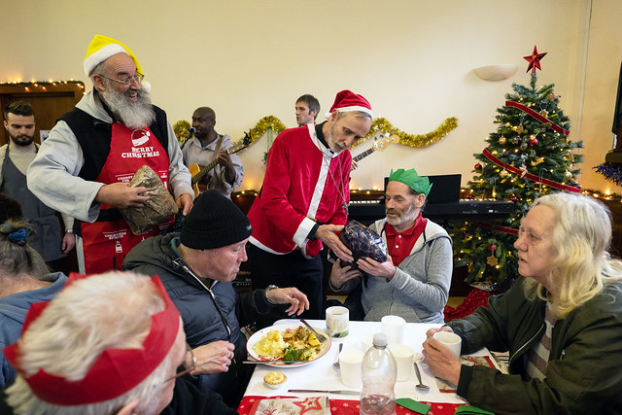


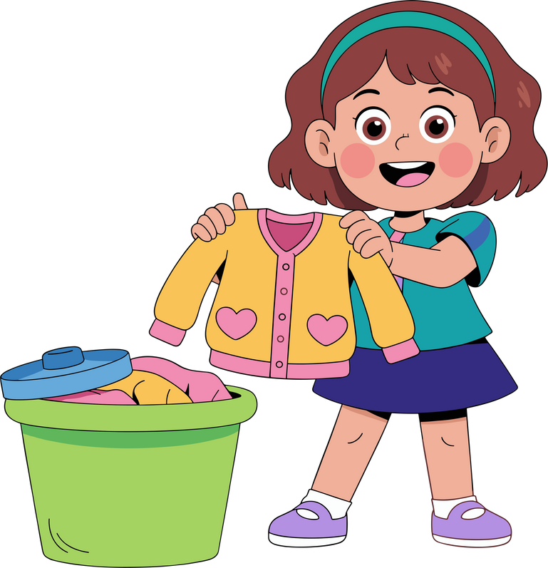
WHAT IS A
SEED OF HOPE?
A seed of hope is a small action we can do to help someone feel loved.
Smiling at somebody
who’s lonely
Saying a prayer
for somebody
Donating food,
toys or clothes
CAN YOU THINK OF SOME MORE SMALL ACTIONS?
PLANTING SEEDS OF HOPE

Slide 7
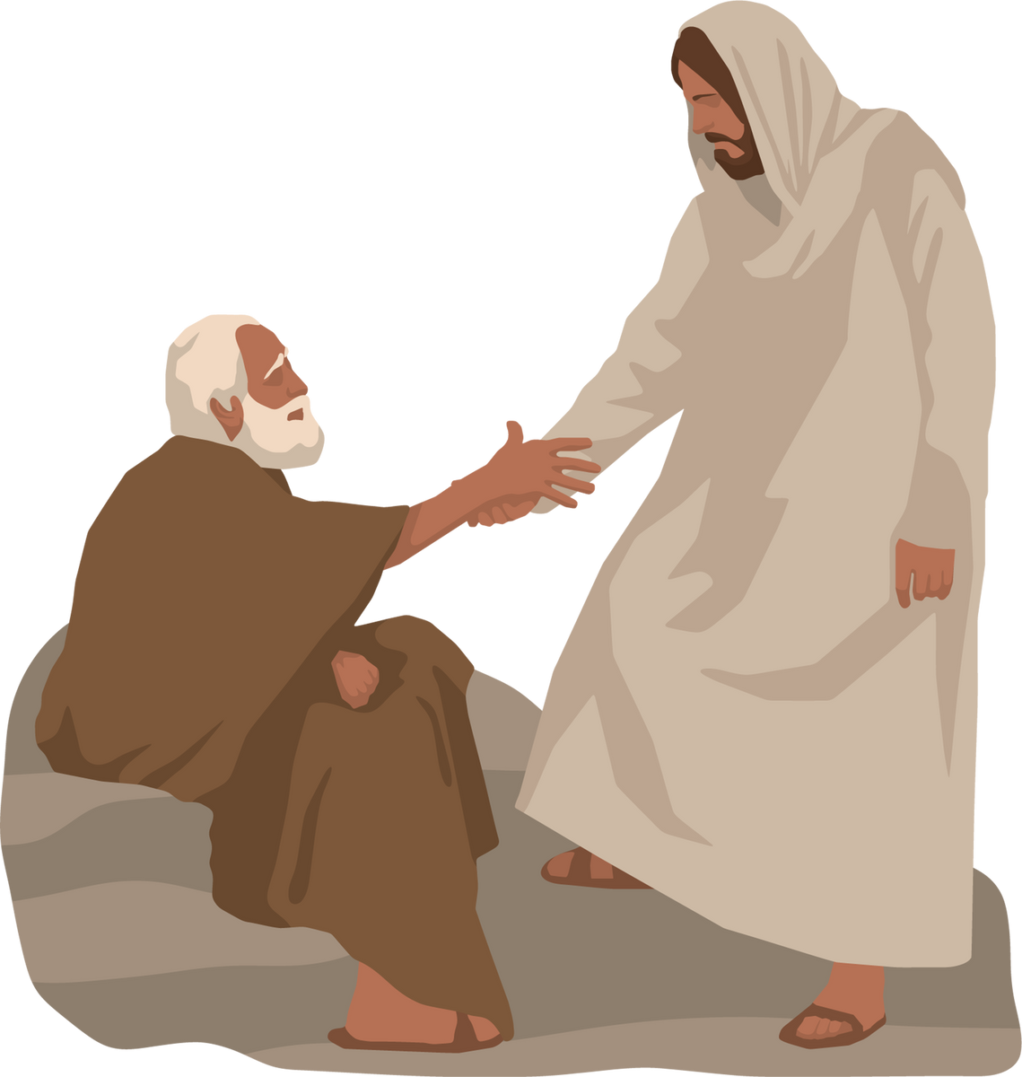
THE BIBLE
AND HOPE
Jesus always helped people who were poor or in need.
Jesus said, “Whatever you did for one of the least of these, brothers and sisters of mine, you did for me.”
Remember:
Whenever we help others,
we are helping Jesus, too
PLANTING SEEDS OF HOPE

Slide 8


CHALLENGE TIME!
We want to ask you to participate in a small project to celebrate World Day of the Poor!
  Can you write a prayer for the people in need?
  Can you make a Hope Tree in your classrooms? (Each leaf could be a seed of hope)
  Or maybe you can think of a new idea?
PLANTING SEEDS OF HOPE

Slide 9





Loving God,
Help us to plant seeds of hope in our world.
Teach us to be kind to the people we meet,
to care for people who need our help,
and to be brave when things are hard.
Show us how to love like Jesus,
with open hearts, gentle words, and helping hands.
Thank You for Your love that never ends,
and for the light that shines in us every day.
Help us to share that light with others,
so the world can grow in love and peace.
Amen.

Slide 10
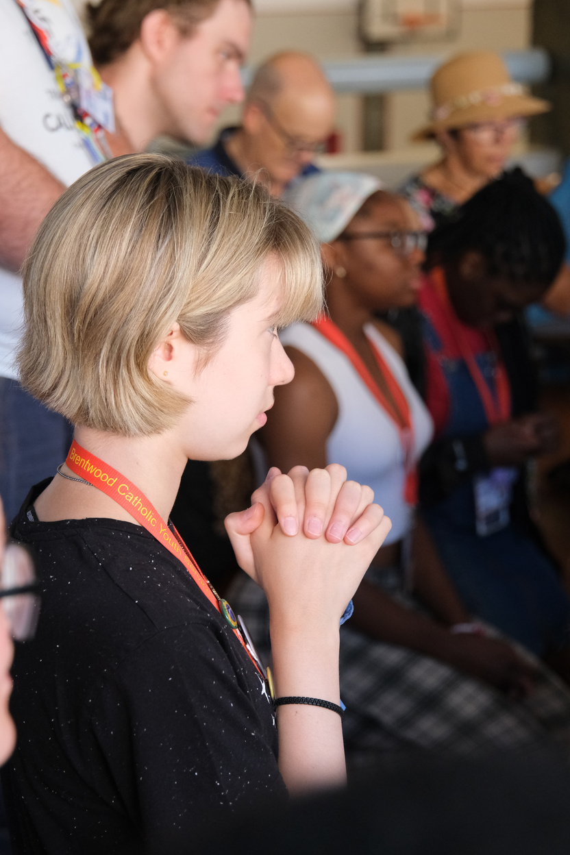
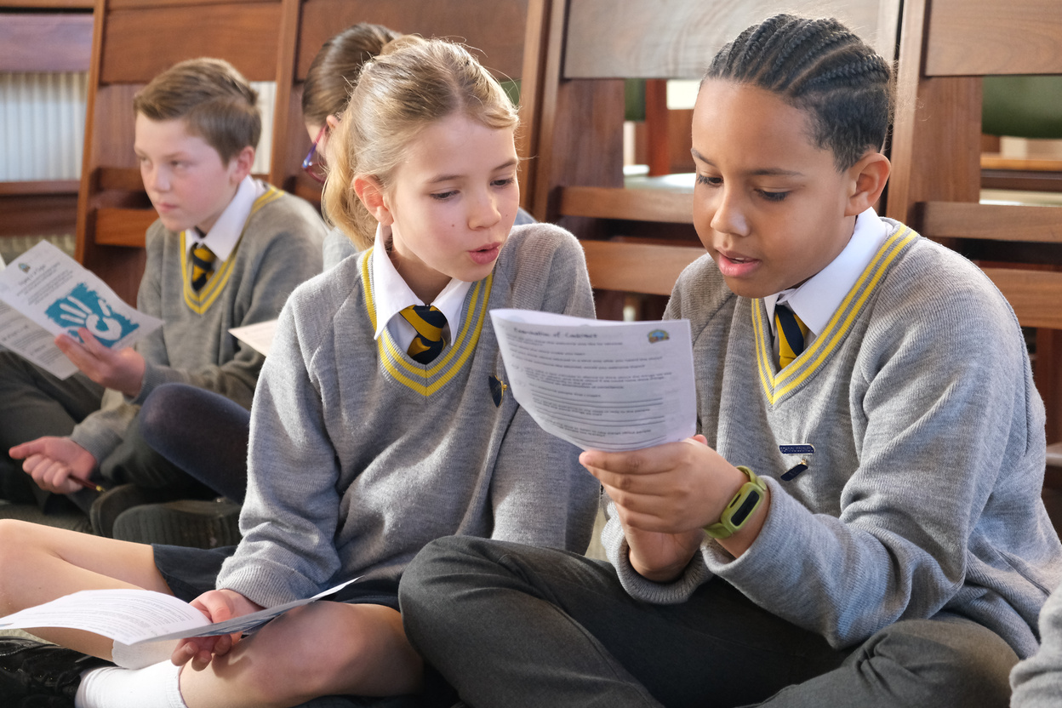
REMEMBER
Even the smallest seed of kindness can grow into a forest of hope!
Let’s go and plant hope in our hearts, our school and our world, just like Jesus did.
PLANTING SEEDS OF HOPE

